Slide 1

Quantitative, qualitative & mixed research
Dr Alveen Singh
Department of Information Technology
Research skills\Project 3A
Advanced Diploma in ICT\B.ICT Degree
Semester 1 2023

Slide 2
Content
A definition for quantitative and qualitative
The purpose of quantitative and qualitative research
How to collect quantitative and qualitative data
On the application of quantitative and qualitative research
Mixed

Slide 3
Definition
The aim of the study determines the strategy i.e. quantitative or qualitative
The choice of quantitative and qualitative in research determines how data is collected and analyzed

Slide 4

Quantitative research usually aims to test or confirm theories or hypothesis
Concerned with numerical data
  Which is transformed into statistics that quantifies (measures) the variables under investigation.
This results are generalizable

Slide 5
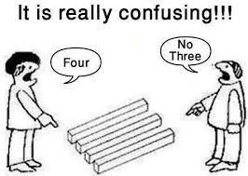
Qualitative research aims to conduct deep investigations and gather in-depth insights into topics that are not well understood.
Qualitative research is generally exploratory in nature.
  It attempts to understand the perceptions, opinions and motivations.
Qualitative research is usually followed by
quantitative research
Prmrinc.net

Slide 6
What is the difference?
  Between qualitative and quantitative research

Slide 7
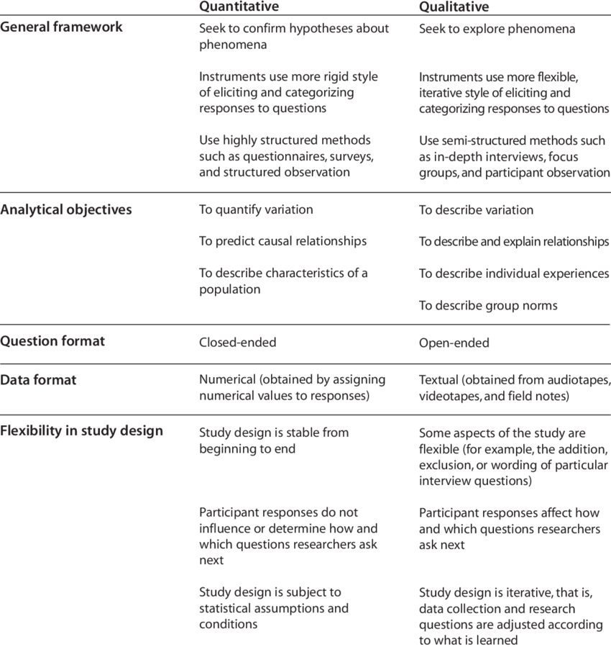
Mack et. Al, 2005

Slide 8
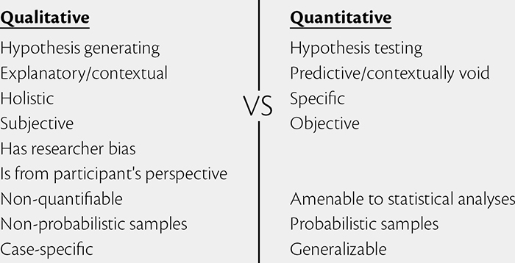
Guest et Al, 2012

Slide 9
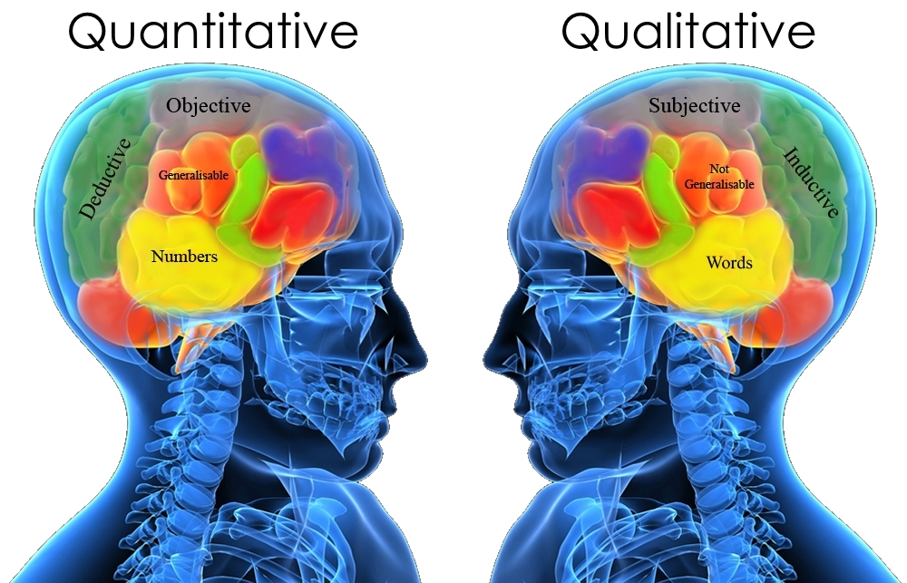
Crenshaw, 2016

Slide 10
Test your knowledge
Pick the qualitative measures
  An air scent that smells nice
  What is the speed of light?
  The crime rate in RSA
  Registered students in this module

Slide 11
Pick the quantitative measures
  Determine the best performing ML technique
  Rainfall in Drakensberg
  Are you feeling hot?
  What is your ethnic origin?

Slide 12
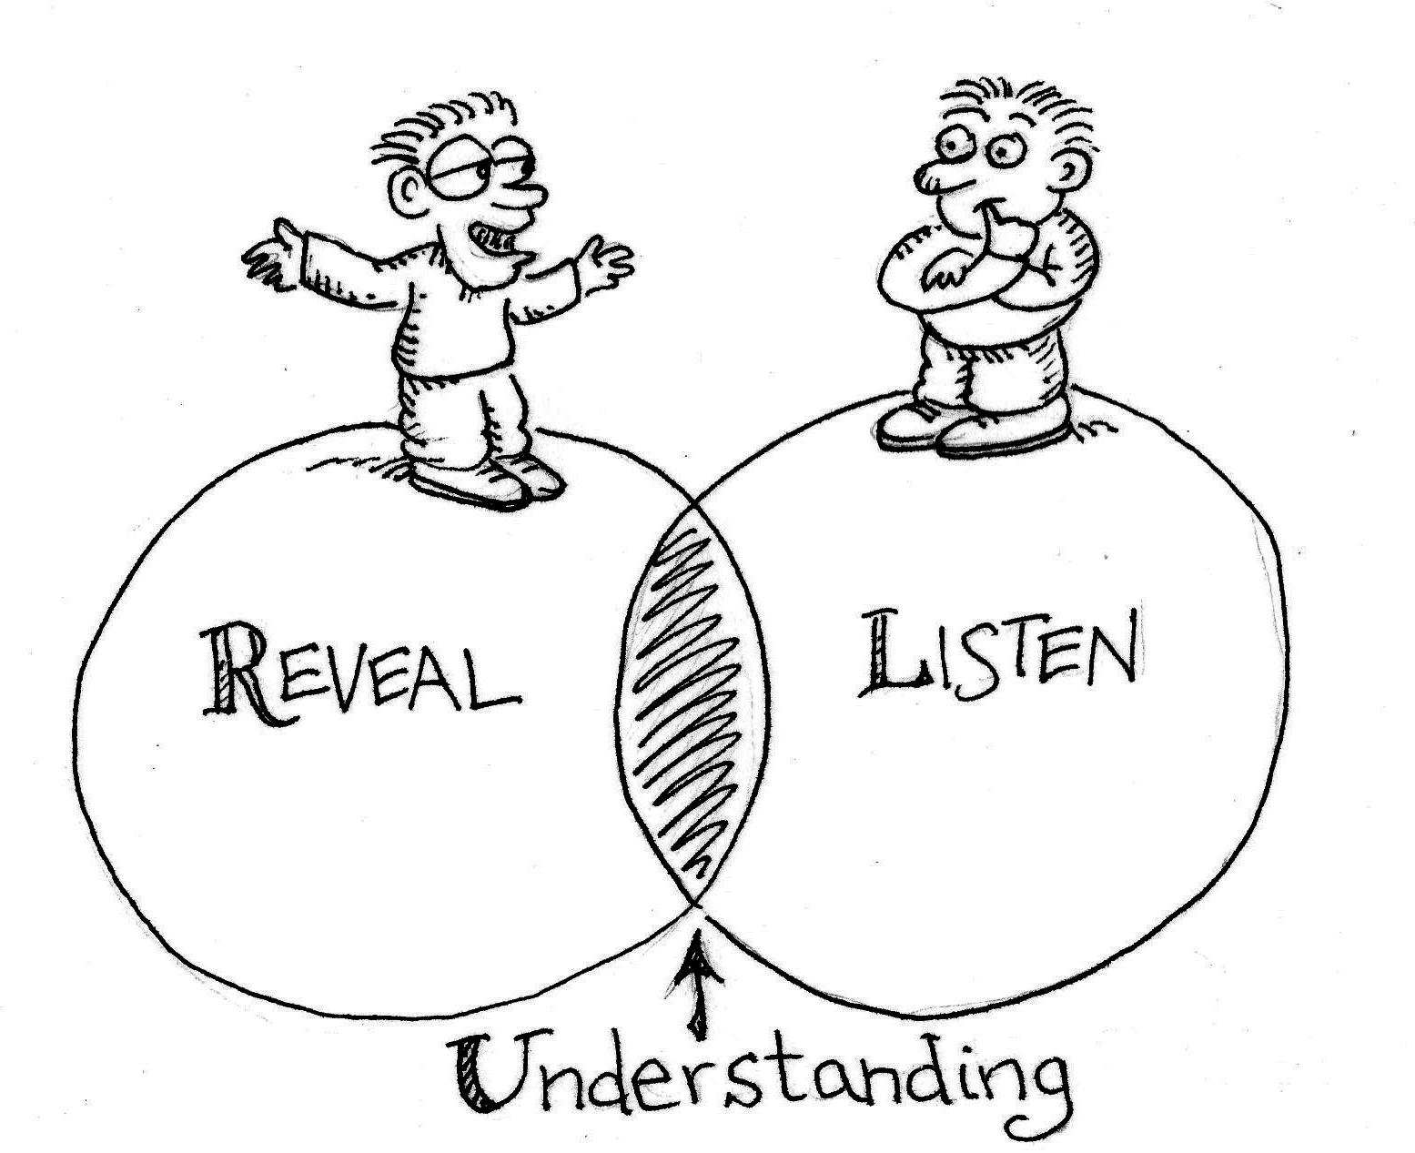
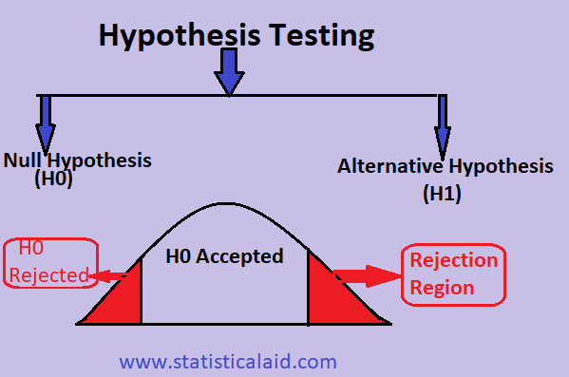

How does the researcher choose the strategy?
Look at the aim of the study. Does the study seek to:
    Explore an unknown phenomenon (why is this happening?) - Qualitative
    Confirm a hypothesis (I think this is happening because of….) - Quantitative
    Develop something new – Quantitative
Zamudio, 2021
Touhidul Islam , 2021
eir.co.za

Slide 13
Which is quantitative? Which is qualitative?
  What is the cause of high first year drop out rate in IT?
  Is KNN better than CNN for cancer cell detection?
  What is the problem with that guy?
  Higher achieving IT students go out on more dates
  What makes Google the best software company to work for?

Slide 14
How does the strategy impact on the data?
Explore an unknown phenomenon (why is this happening?) – Qualitative
  Data Collection
    open ended questions, opinions, perspectives, un-structured interviews, observation
    Twitter, Facebook, VLE Chats, Chatbot queries etc.
    Whatsapp video clips; sound recordings
      unstructured data
  Data Analysis
    Thematic analysis to id recurrent themes (e.g. most participants said that MST is useful)
    Grounded theory
  Result
    A theory about something
    This theory now needs to be validated

Slide 15
How does the strategy impact on the data?
Confirm a hypothesis, experiment or design research - Quantitative
  Data Collection
    Online survey, closed-ended questions, linkert-scale
    Data from WSN; IoT sensors; network traffic
    Online dataset: images; banking transactions; millions of records for business transactions
    From conducting experiments e.g. comparing ML, CV, DL or other models using metrics; testing new architectures and designs
      Structured data
  Data Analysis
    Mathematical techniques
    Statistical analysis (testing)
  Result
    Validated result
    Proven innovation

Slide 16
Test your knowledge
Are these qualitative or quantitative research?
  Internet of Things: Challenges and Perspectives in Sub-Saharan Africa
  Software-defined networks (SDNs) and Internet of Things (IoTs): A prediction
  Determining the best ML technique for disease identification in reef breeding fish
  Census 2050

Slide 17
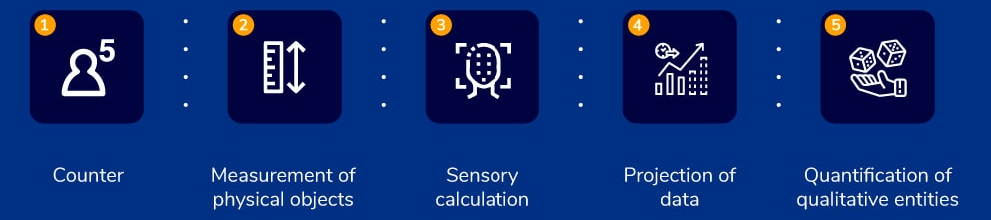
What is the difference in data collection?
Quantitative data is numerical
Quantitative data is structured and statistical
The results are objective and conclusive.
Quantitative data is collected from experiments, surveys and secondary data (e.g. ITS reports of student assessment marks).
QuestionPro

Slide 18
An example of quantitative data might be:
A survey of 300 1st year IT students and ask them questions such as: “on a scale from 1-5, how satisfied are you with provisioned computer laboratories?”
  Statistical analysis can be performed on the data and draw conclusions such as: “on average students rated computer laboratories at 4.4”

Slide 19

Qualitative data is non-numerical and unstructured.
Data seeks to describe a topic more than measure it.
Data is usually collected from focus groups, interviews, observations and is collected in the natural setting.
There usually are no simulations or
experiments.
QuestionPro.com

Slide 20
Test your knowledge
Which is structured and which is unstructured data?
  Tweets
  Test marks for a class
  Facebook comments
  Data transmitted from WSN used in distribution warehouse
  Lecture content on Moodle
  Comparative results of competing ML models

Slide 21
An example of qualitative data might be:
Conduct in-depth interviews with 15 1st year IT students and ask them open-ended questions such as:
  “How satisfied are you with provisioned IT labs?”,
  “What is the most positive aspect of the IT labs?” and
  “What can be done to improve the IT labs?”
The responses are “perceptions, opinions”
mostly textual format

Slide 22


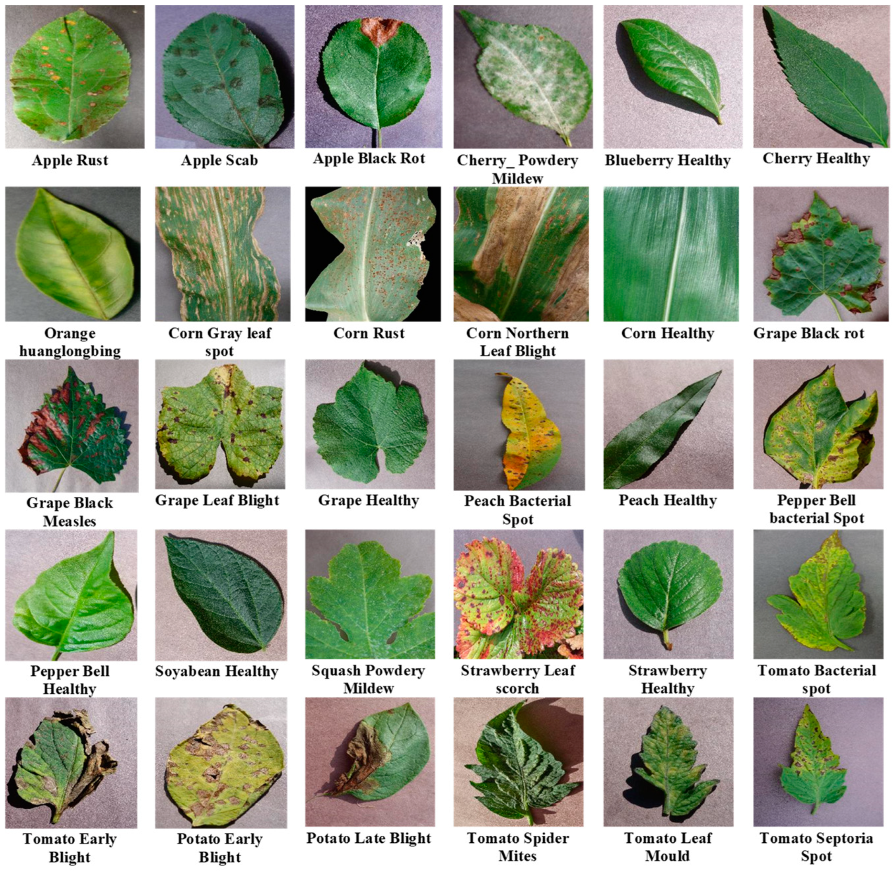

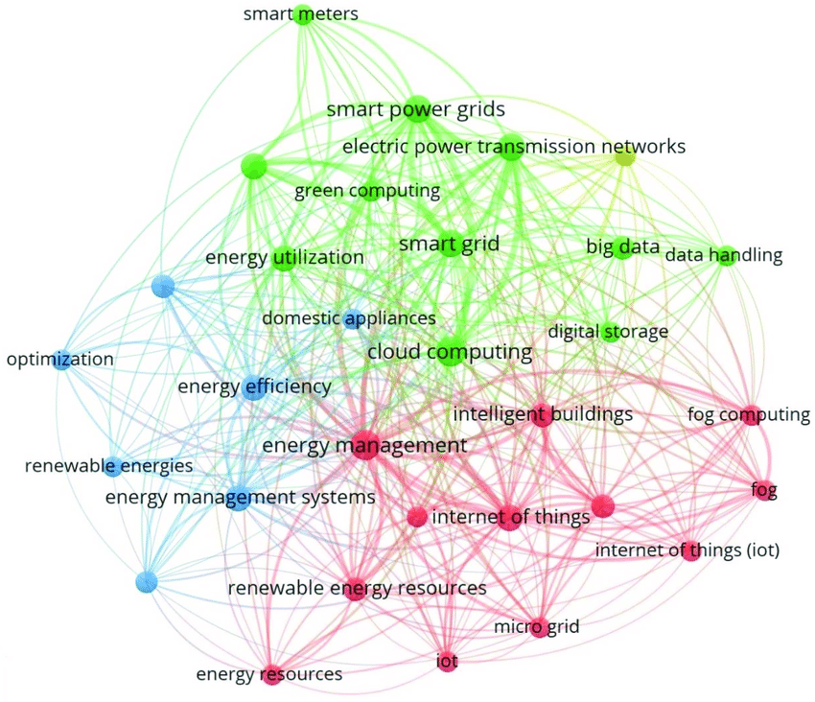


Which is qualitative and which is quantitative?

Slide 23
Mixed Research
Mixed research is a combination of qualitative and quantitative.
It usually involves data collected in unstructured, qualitative format from interviews, open ended questions, social media, video and sound clips.
This data is transcribed or pre-processed into a numerical format.
For example, data pertaining to race groups Indian, White, Black, Coloured, Other can be transcribed into a structured numerical format Indian=1; White=2; Black=3; Coloured=4; Other=5.
Statistical or mathematical analysis techniques can then be applied.
Mixed research provides scientific rigour to the analysis of qualitative data.

Slide 24
Application of quantitative and qualitative
Use quantitative research if you want to confirm or test something (a theory or hypothesis)
Use qualitative research if you want to understand something (concepts, thoughts, experiences)
Use mixed research when data is available/collected in qualitative format but analysed using quantitative statistical or mathematical methods
(Scribbr, 2021)

Slide 25
Please read the lecture note for this section.
Available on Moodle.
Questions and comments are welcome: alveens@dut.ac.za

